Slide 1
The Effect of Fault Impedance Angle on Fault Location
Elevate Energy: Robert Orndorff, Kyle Thomas, Ana Ospina
Softstuf: Amir Makki, Maria Rothweiler

Slide 2
How can we tell if a Calculated Fault Location is
Good or Bad?
A good answer is to check the Angle Difference between
Line Impedance and Measured Impedance
The following is a tutorial with 7 real life events including
Single Phase, Phase to Phase, and 3 Phase examples

Slide 3
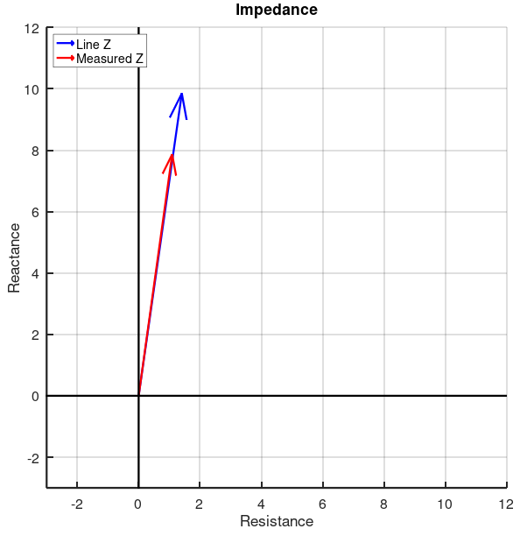
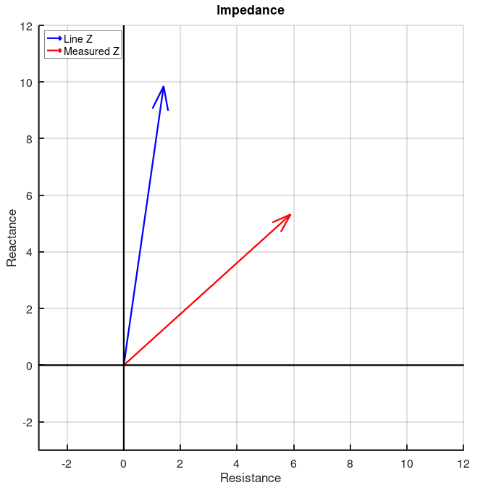
The Main Concept:
Good Location: High Confidence
Bad Location: Medium to Low Confidence
But we can Improve

Slide 4
Summary
If the angle difference is close to zero and the measured fault magnitude is in range with the line impedance magnitude,
then it’s a Good Location
 | Z Mag ~ 0 | Z Mag <= Line Z Mag | Z mag > Line Z mag
Angle difference < 10 | High | High | Low
10 < Angle Difference < 40 | High | Medium | Low
Angle Difference > 40 | High | Low | Very Low

Slide 5
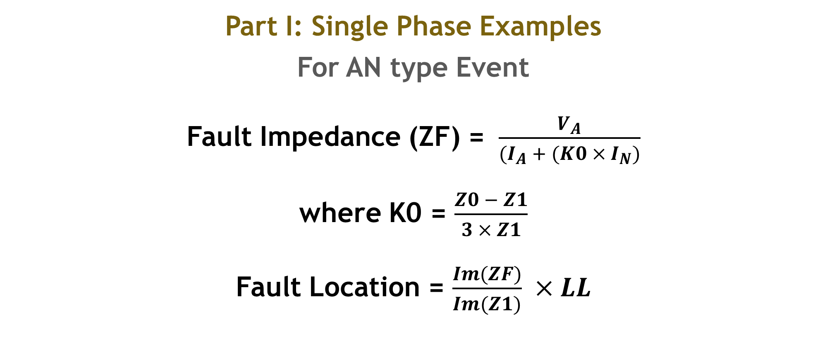
Part I: Single Phase Examples
For AN type Event
Fault Impedance (ZF) = $\frac{V_{A}}{(I_{A} + (K0 × I_{N})}$
where K0 = $\frac{Z0 − Z1}{3 × Z1}$
Fault Location = $\frac{Im(ZF)}{Im(Z1)} ×LL$

Slide 6
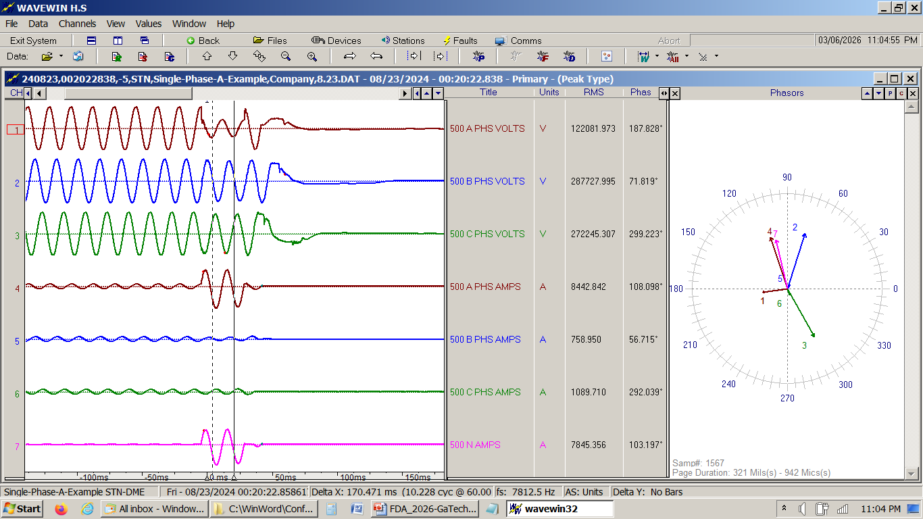
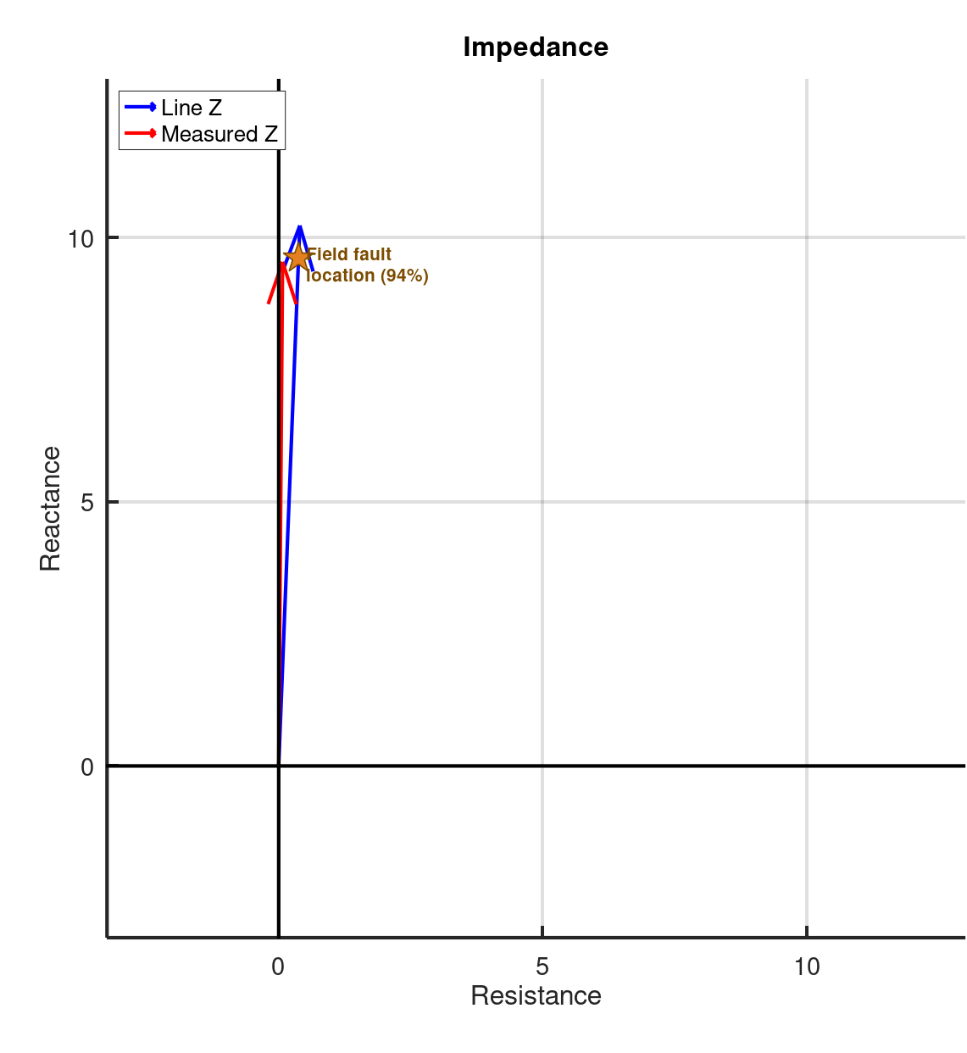
Example-1: Single Phase – Good Angle Difference
500kV - Phase A to Ground - 8kAmps RMS
Va
Vb
Vc
Ia
Ib
Ic
In
Line Z = 10.233 @ 87.76 Ω | Actual = 8.23 miles | LL = 8.77 miles
Fault Z =9.537 @ 89.56 Ω | Calculated = 8.18 miles | Angle Difference = 1.8°
Angle difference is small and ZF magnitude is reasonable, so the Confidence is High

Slide 7
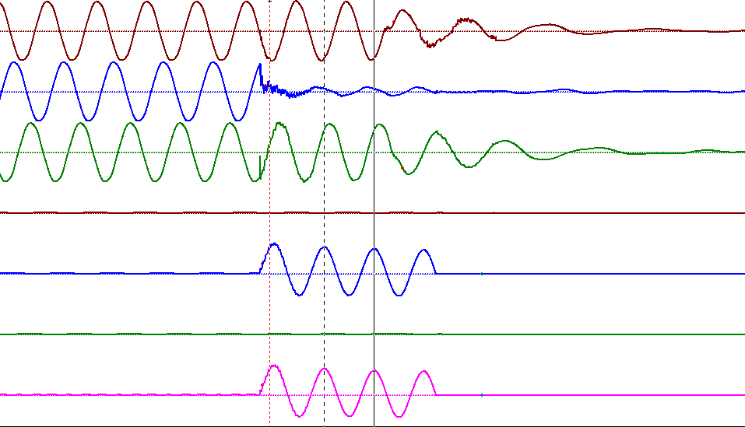
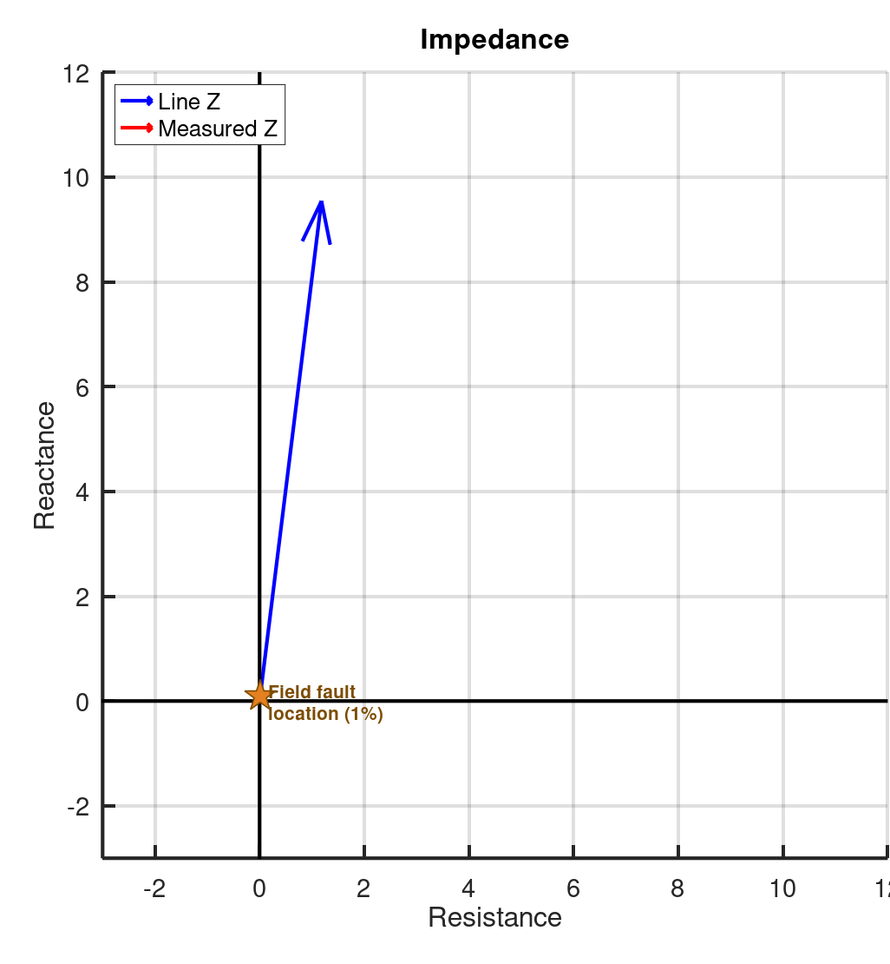
Example-2: Single Phase - Lightning Strike
115kV - Phase B to Ground - 30kAmps RMS
Line Z1 = 9.615 @ 82.94 Ω | Actual = 0.0 miles | LL = 13.2 miles
Fault Z =0.183 @ 42.26 Ω | Calculated = 0.1 miles | Angle Difference = 40.68°
Angle difference is large but ZF magnitude is almost zero, so the Confidence is High

Slide 8
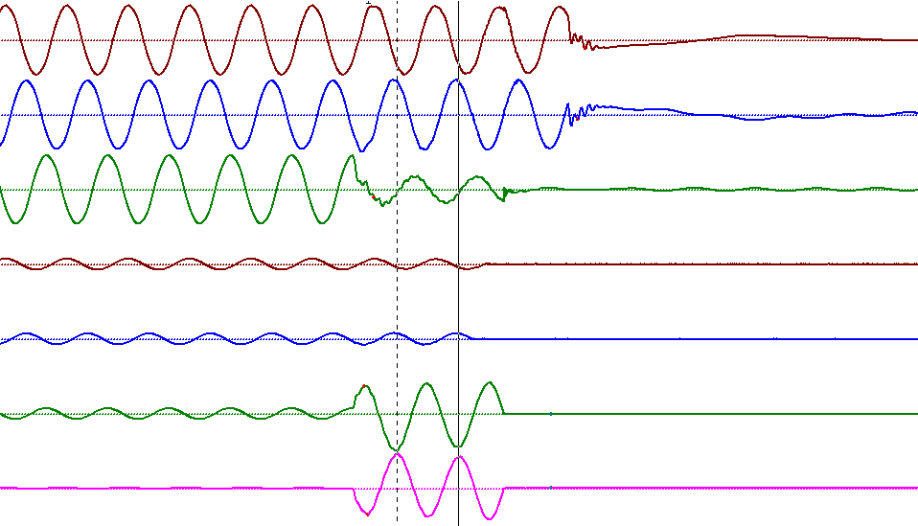
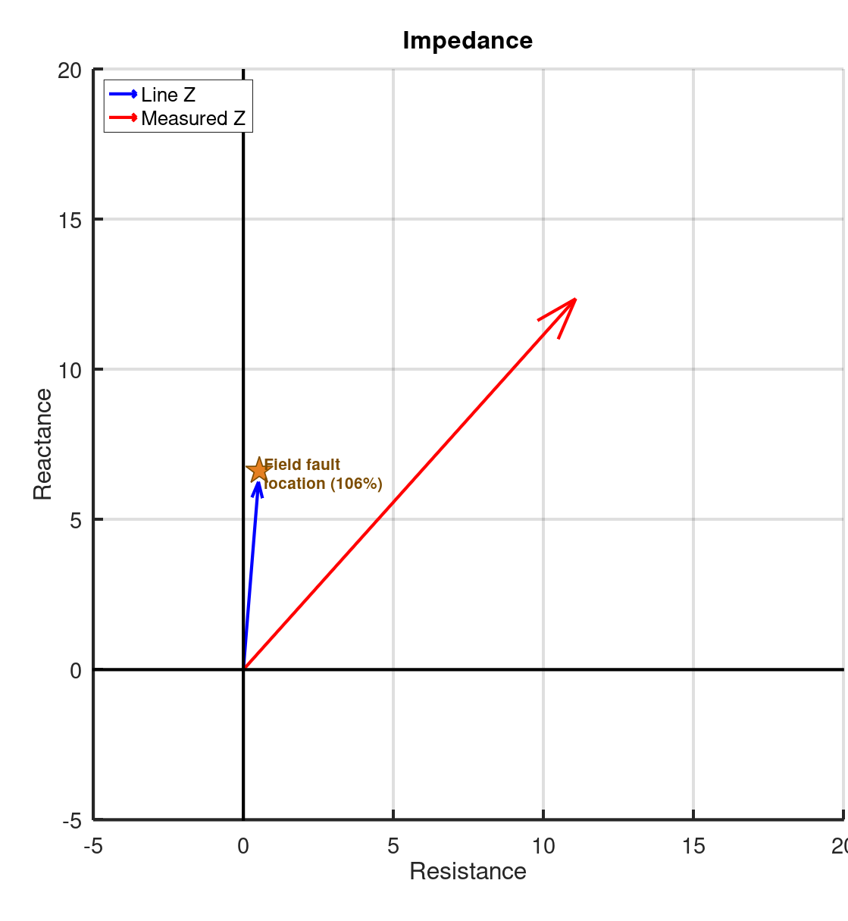
Example-3A: Single Phase – Reverse Polarity
230kV - Phase C to Ground - 5kAmps RMS
Line Z1 = 6.268 @ 85.401 Ω | Actual = 8.9 miles | LL = 8.37 miles
Fault Z =16.584 @ 48.13 Ω | Calculated = 16.5 miles | Angle Difference = 37.27°
Angle difference is large and ZF magnitude is not reasonable, so the Confidence is Low

Slide 9
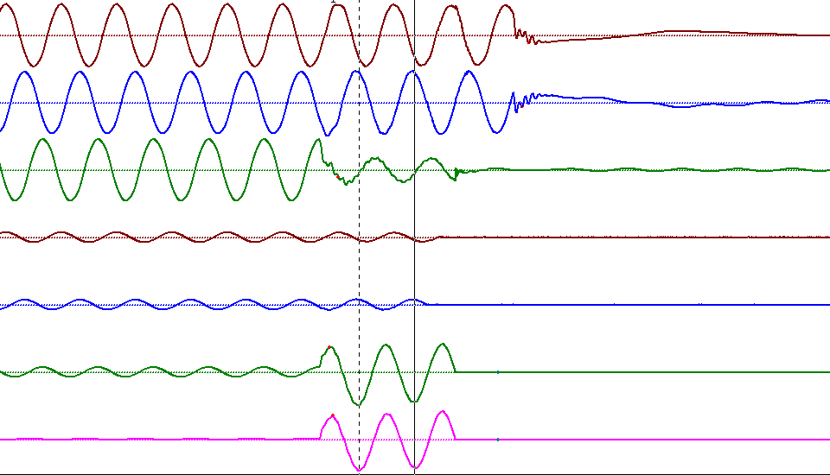
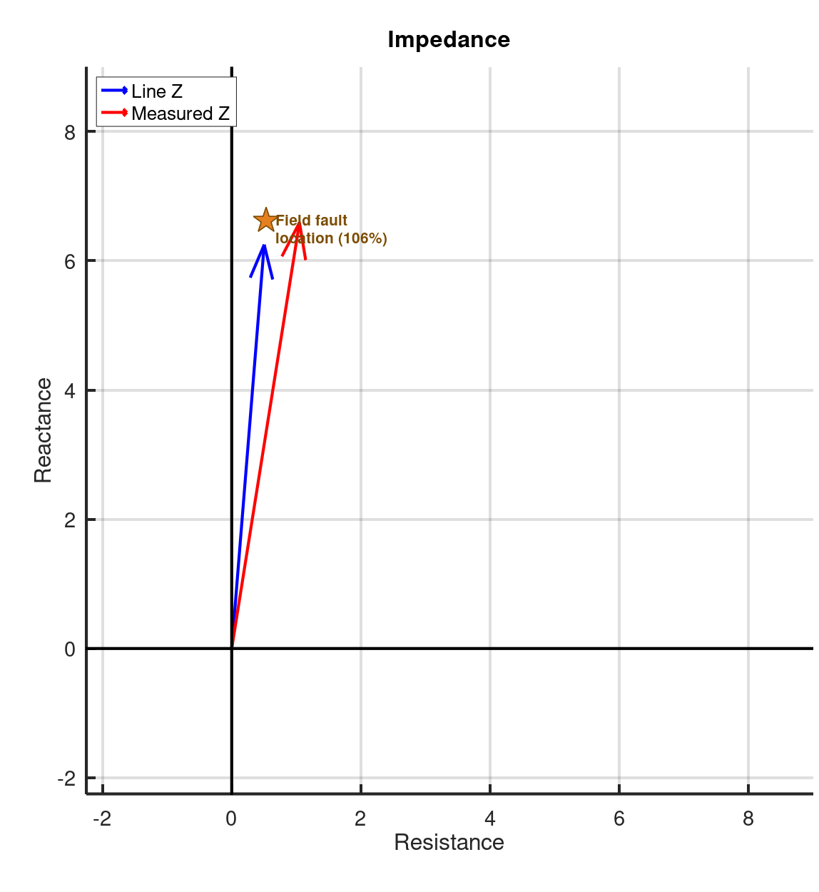
Example-3B: Single Phase – Reverse Polarity Corrected
230kV - Phase C to Ground - 5kAmps RMS
Line Z1 = 6.268 @ 85.401 Ω | Actual = 8.9 miles | LL = 8.37 miles
Fault Z =6.674 @ 80.96 Ω | Calculated = 8.827 miles | Angle Difference = 4.44°
Angle difference is small and ZF magnitude is reasonable, so the Confidence is High

Slide 10
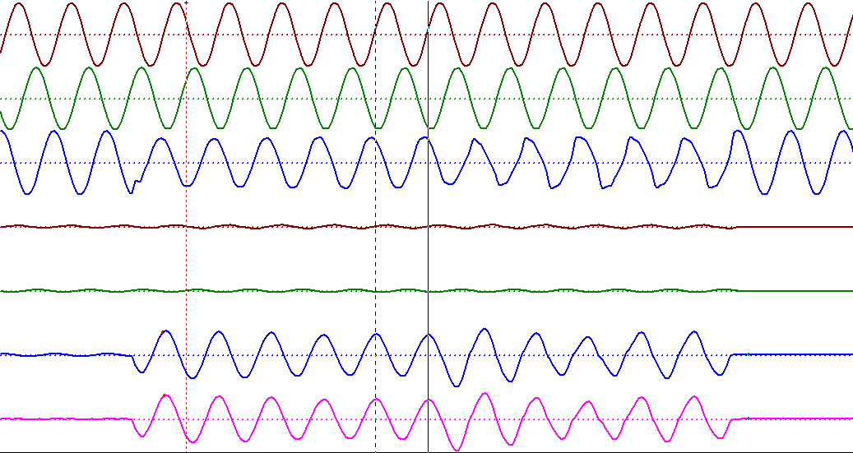
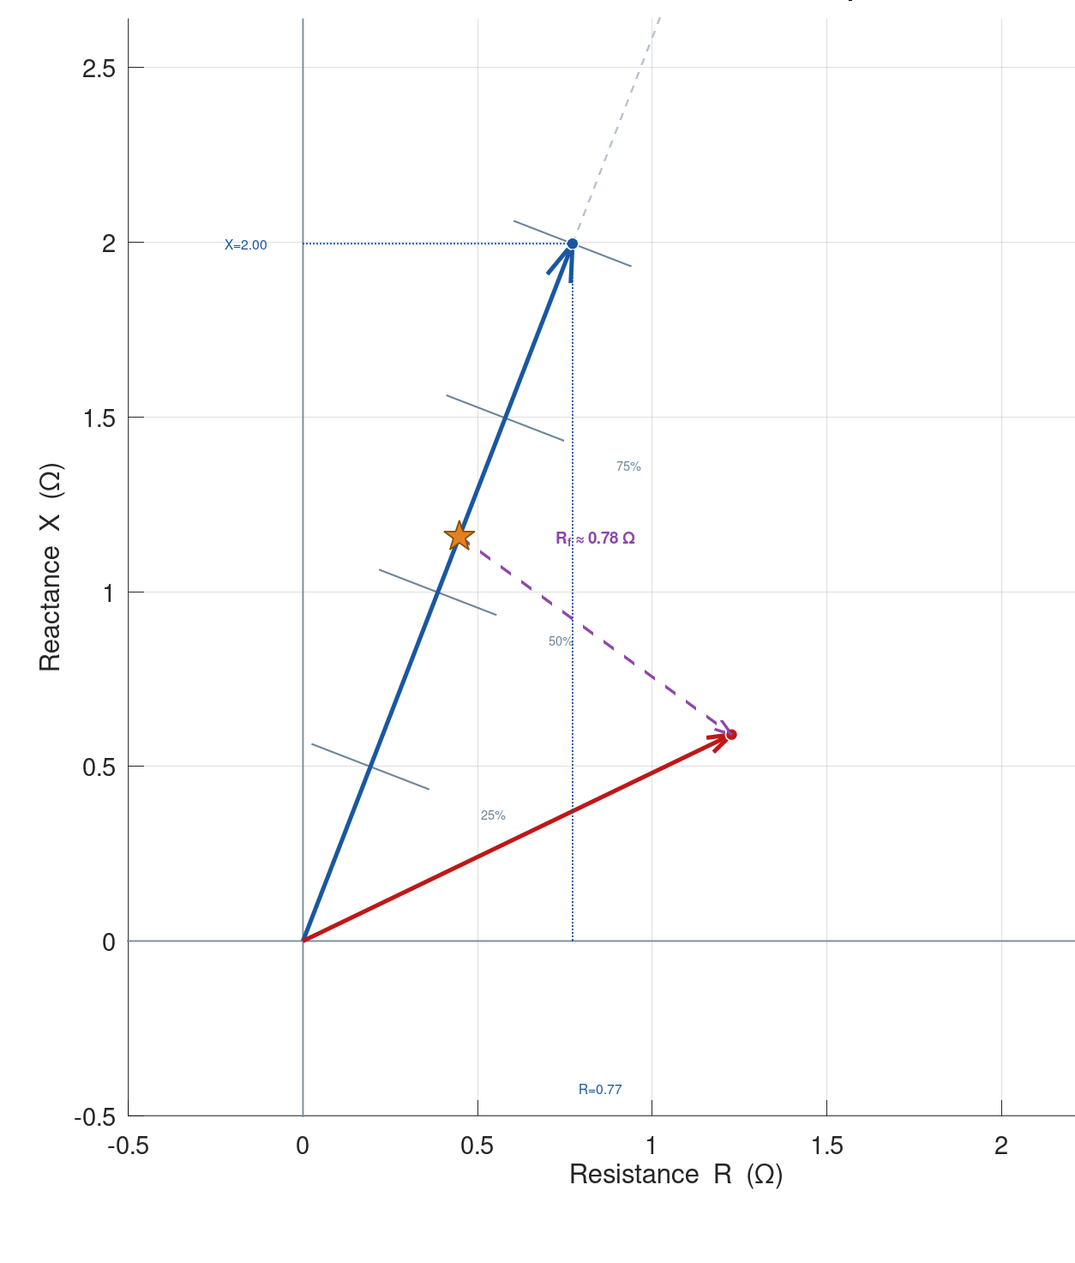
Example-4: Single Phase – High Resistance Fault
13.8kV - Phase C to Ground - 3kAmps RMS
Line Z1 = 2.14 @ 68.86 Ω | Actual = 2.8 miles | LL = 4.84 miles
Fault Z =1.362 @ 25.71 Ω | Calculated = 1.432 miles | Angle Difference = 43.15°
Angle difference is large and ZF magnitude is reasonable, so the Confidence is Low

Slide 11

Part II: Phase to Phase Examples
For an AB type Event
ZF = $\frac{(V_{A} − V_{B})}{(I_{A} − I_{B})}$

Slide 12
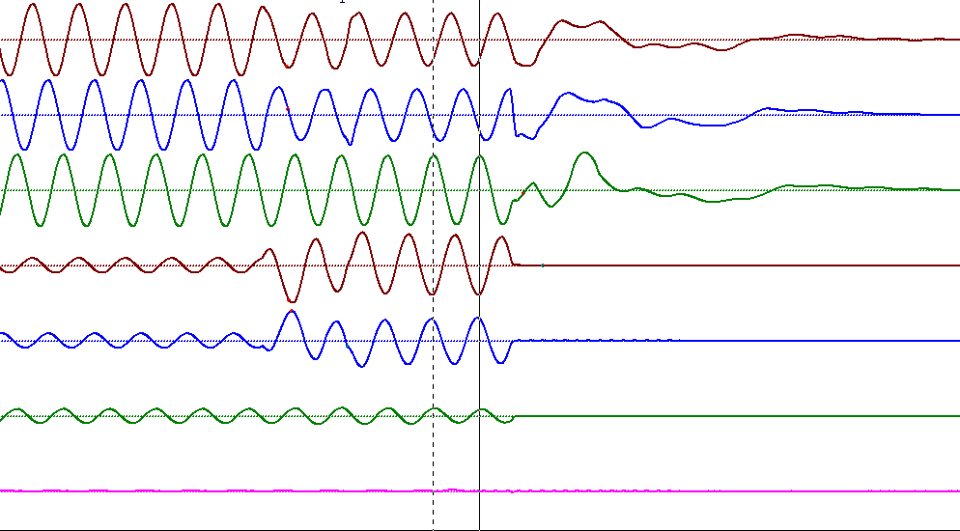
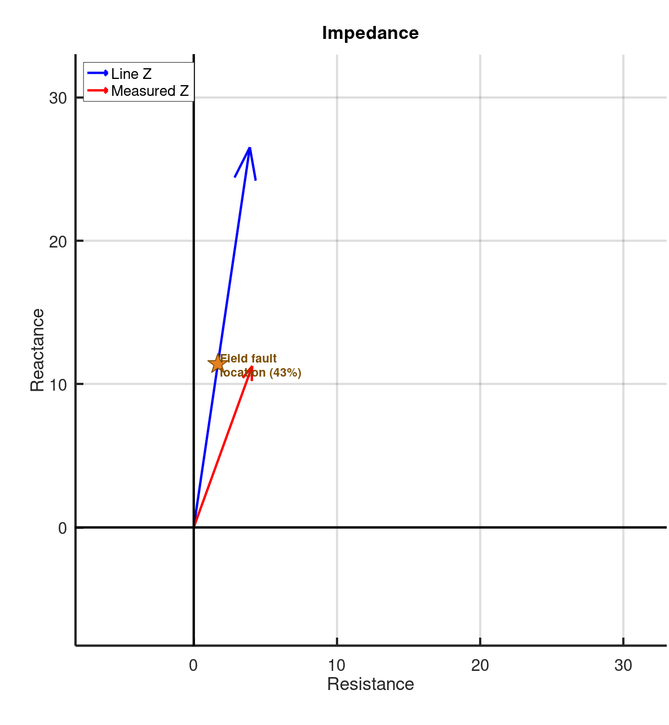
Example-5: Phase to Phase – Small Differences in Z1 and LL
115kV - Phase A to B – 6.1kAmps RMS
Line Z1 = 26.806 @ 81.602 Ω | Actual = 14.66 miles | LL = 33.85 miles
Fault Z = 11.93 @ 70.08 Ω | Calculated = 14.815 miles | Angle Difference = 11.522°
Angle difference is not too large and ZF magnitude is reasonable, so the Confidence is High

Slide 13
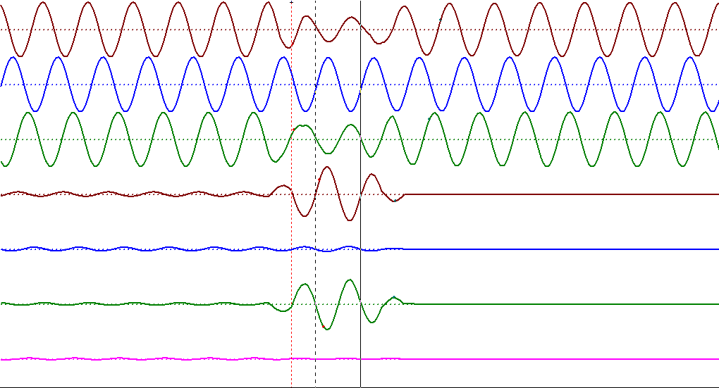
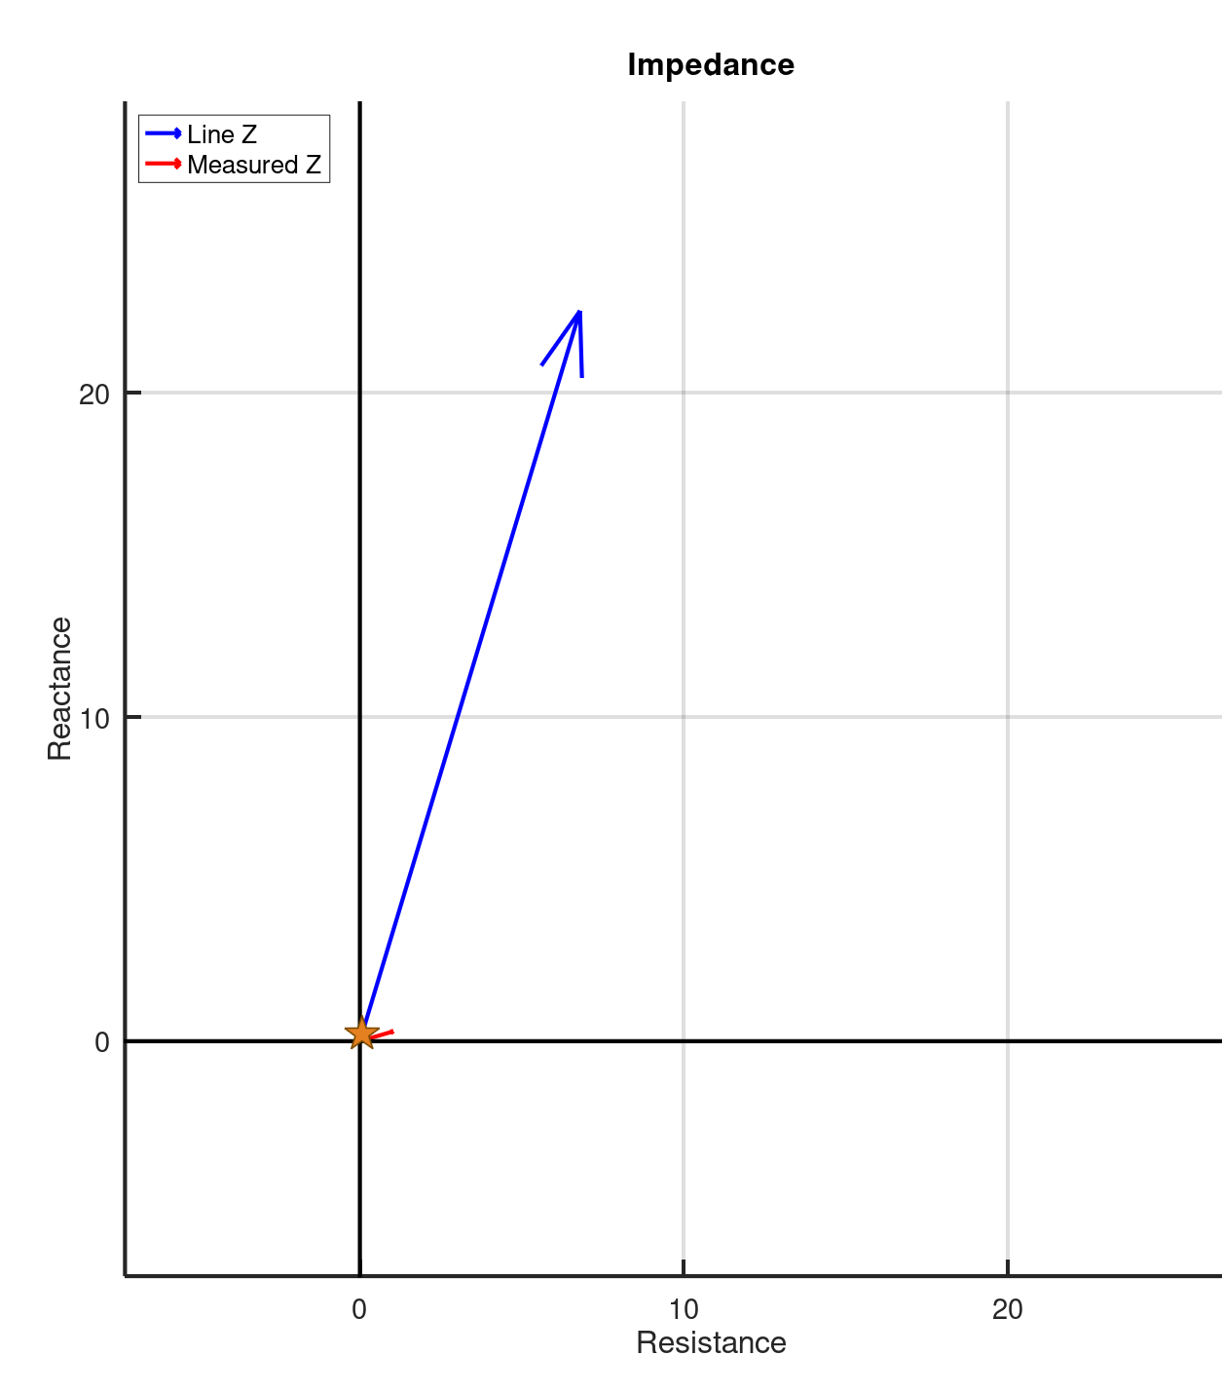
Example-6: Phase to Phase – High Resistance Fault
115kV - Phase A to C – 6.2kAmps RMS
Line Z1 = 23.537 @ 73.22 Ω | Actual = 0.4 miles | LL = 25.21 miles
Fault Z =1.076 @ 16.37.71 Ω | Calculated = 0.63 miles | Angle Difference = 56.85°
Angle difference is large, but ZF magnitude is low, so the Confidence is High

Slide 14

Part III: Three Phase Example
For an ABC type Event
ZF = $\frac{V1}{I1}$
where V1 and I1 are Positive Sequence quantities

Slide 15
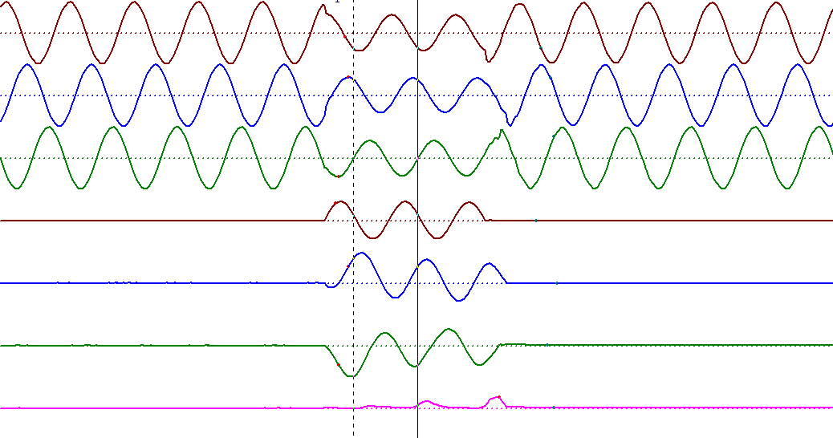
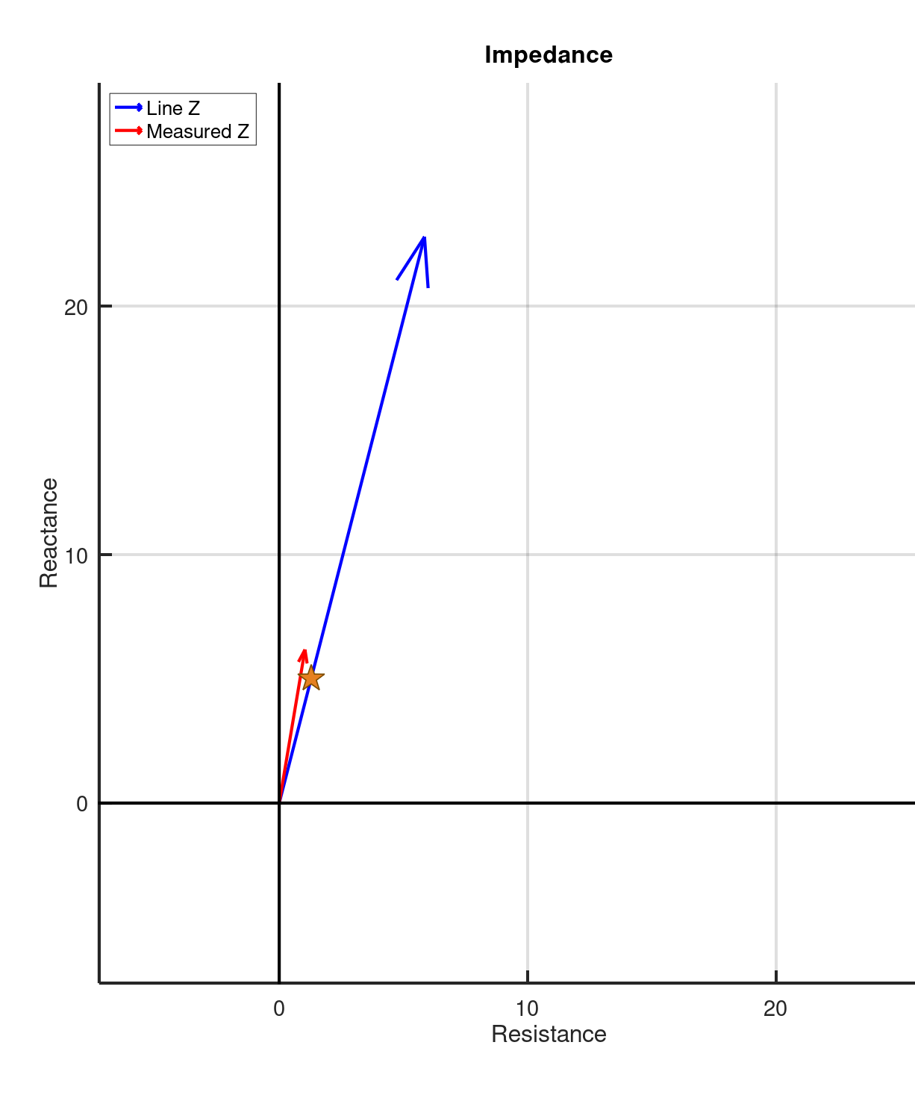
Example-7: Three Phase – Balanced with DC Offset
115kV - Phase ABC – 8.2kAmps RMS
Line Z1 = 28.551 @ 75.607 Ω | Actual = 7.9 miles | LL = 36.46 miles
Fault Z = 6.2621 @ 80.475 Ω | Calculated = 7.968 miles | Angle Difference = 4.868°
Angle difference is small and ZF magnitude is reasonable, so the Confidence is High

Slide 16
Part IV: Double Ended – Bonus Example
V_{NS} = Near side bus voltages
V_{FS} = Far side bus voltages
I_{NS} = Near side line currents
I_{FS} = Far side line currents
V_{F} = Fault voltages
I_{F} = Fault currents
R_{F} = Fault resistances
Z_{L} = Line impedance between
Fault Location (PU) = (V_{NS} – V_{FS} + Z_{L} I_{FS}) / Z_{L} (I_{NS} + I_{FS})
Where the Bus Voltages and Currents are +, 0, or – Sequence Components

Slide 17
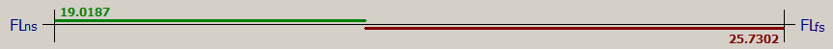
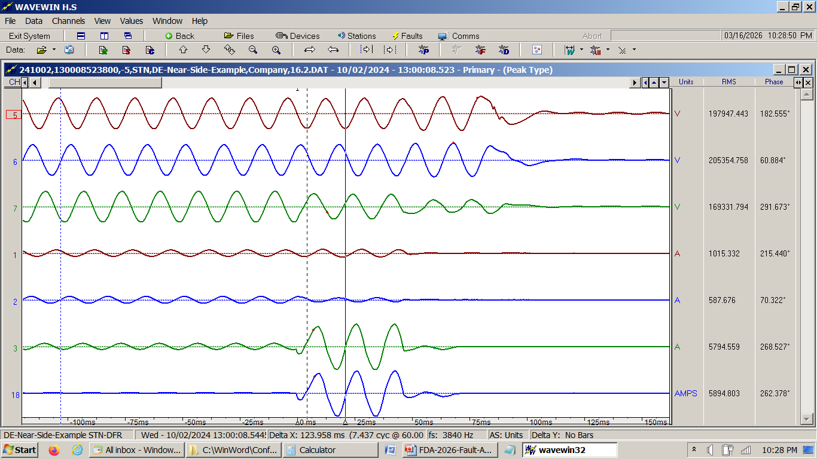
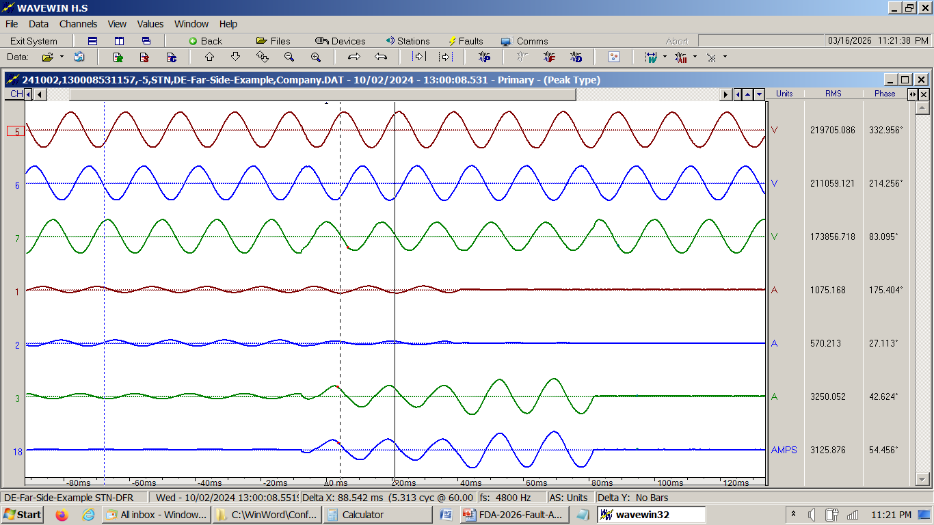
Bonus Example: Double Ended – Works for all Event Types
345kV – Phase CN – 9.5kAmps RMS
Near Side - 6kAmps RMS
Far Side – 3.5kAmps RMS
Near Side Angle = 3.12° | Calculated NS = 19.02 miles | LL = 44.7 miles
Far Side Angle = 2.3° | Calculated FS = 25.76 miles | Actual = 19.1 miles
Angles are small and Magnitudes add up to LL, so the Confidence is High

Slide 18
Conclusions
The angle difference between measured impedance and line impedance is not often discussed, however the authors have found:
This angle can provide useful information about the (accuracy, quality, correctness, confidence?) of the location calculation.
By looking at the magnitude of the measured fault impedance we get another factor that can be used to determine the confidence of the estimated fault location.
When the measured magnitude is very low, around 5% or less of the line impedance magnitude, then the angle becomes less important in determining confidence.
 | Z Mag ~ 0 | Z Mag <= Line Z Mag | Z mag > Line Z mag
Angle difference < 10 | High | High | Low
10 < Angle Difference < 40 | High | Medium | Low
Angle Difference > 40 | High | Low | Very Low

